Slide 1

Car Market Trend Analysis with Car Dekho Data
AICTE STU ID : STU6424333ea35b91680094014
[Manikanta Subbarao B ]

Slide 2

PROBLEM STATEMENT
Problem Statement: Pricing Asymmetry and Inefficient Valuation in the Used Car Secondary Market
In the used car marketplace, accurately pricing pre-owned vehicles is complex due to multiple interacting variables such as depreciation over time, mileage accumulated, fuel engine type, transmission mechanism, seller channel, and previous ownership history. Inaccurate valuation leads to delayed sales, lost margins for dealers, and unfair pricing for consumers.
This project addresses the challenge of analysing historical used car transaction data to discover pricing trends, understand key price drivers, and extract actionable insights for optimal vehicle pricing.

Slide 3
Project Description
The Car Dekho Used Car Data Analysis & Price Prediction Project performs End-to-End Data Analysis (EDA) on a dataset of 301 used vehicle listings. The dataset contains structural metadata including listing price, current showroom price, total kilometres driven, fuel type (Petrol, Diesel, CNG), seller category (Dealer vs. Individual), transmission (Manual vs. Automatic), and owner history.
Key Phases Covered in Analysis:
Data Cleaning & Exploration: Verification of data types, check for missing values, numerical summary statistics, and categorical distributions.
Feature Engineering: Calculating vehicle age based on manufacture year (Current Year - Year) and price depreciation percentage ((Present_Price - Selling_Price) / Present_Price * 100).
Univariate & Bivariate Exploratory Data Analysis:
Distribution of selling prices vs. current showroom prices.
Correlation analysis between vehicle age, kilometers driven, and selling price.
Price impact of categorical variables (Fuel Type, Seller Type, Transmission).
Actionable Insights Generation: Data-driven recommendations for pricing strategy, inventory acquisition, and market positioning.

Slide 4
Key Insights & Analytical Findings
Age vs. Value Retention: Vehicle age shows a strong negative correlation with selling price; cars lose significant value within the first 3 to 5 years.
Fuel Type Dynamics: Diesel vehicles command higher average selling prices and retain value better than Petrol counterparts, largely driven by commercial and long-distance demand.
Transmission Premium: Automatic vehicles hold higher resale values compared to Manual models, reflecting market demand for modern driving convenience.
Seller Channel Variance: Dealer listings reflect higher average price points compared to direct Individual seller listings, accounting for reconditioning and dealership markup.

Slide 5

END USERS
Automotive Dealerships & Resellers: To establish optimal buying and selling price points, maximizing turnover rate and profit margins.
Car Dekho / E-commerce Platforms: To power automated pricing evaluation algorithms and recommend realistic listing prices to sellers.
Individual Buyers & Sellers: To evaluate fair market value when negotiating used car purchases or listings.
Financial Analysts & Insurance Providers: To determine vehicle depreciation curves and collateral values for auto loans and insurance claims.

Slide 6

Technology Used
Programming Language: Python 3.x
Data Manipulation & Processing: Pandas, NumPy
Data Visualization: Matplotlib, Seaborn
Development Environment: Jupyter Notebook / Visual Studio Code

Slide 7
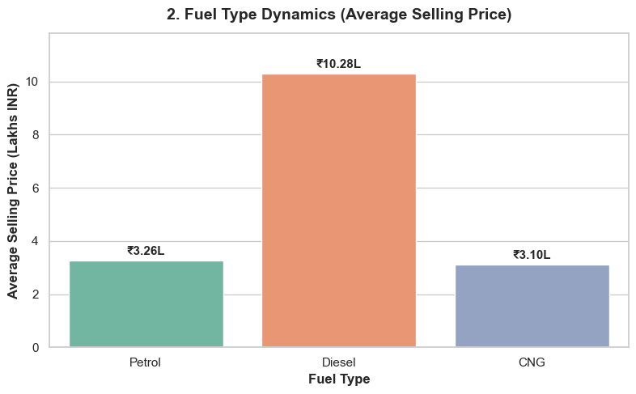
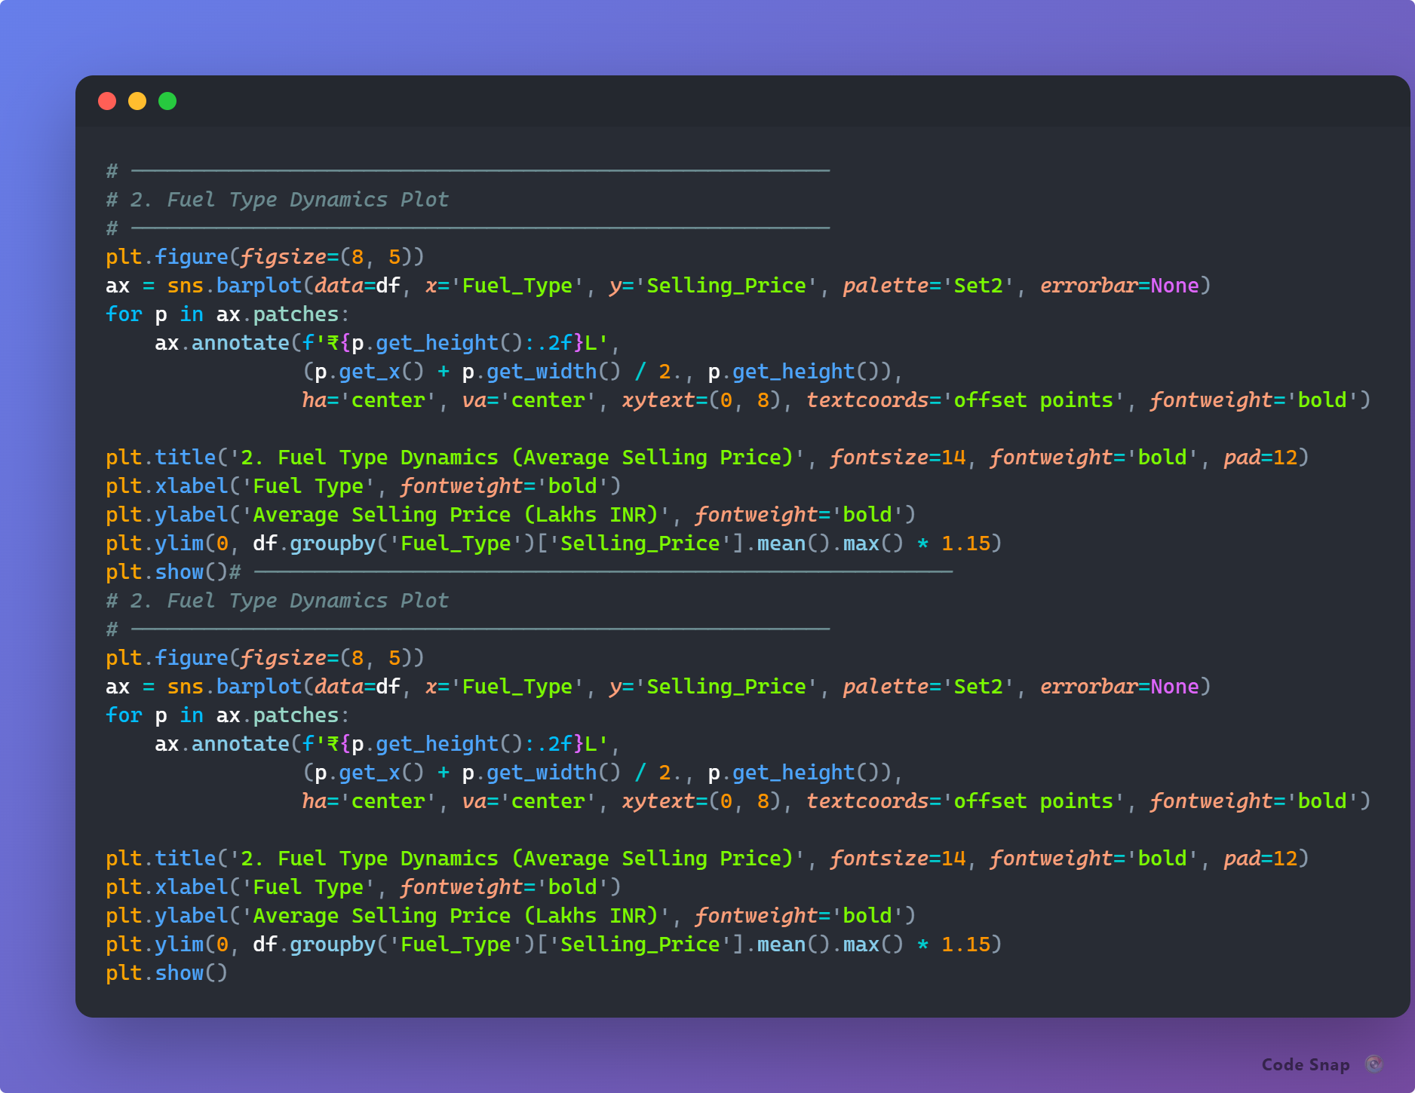
RESULTS
3x Value Premium for Diesel: Diesel vehicles command a significantly higher average selling price (₹10.28 Lakhs) compared to Petrol (₹3.26 Lakhs) and CNG (₹3.10 Lakhs) due to stronger long-distance demand and higher initial vehicle acquisition cost.
Market Volume Disparity: Petrol cars account for the majority of market listings (239 out of 301 cars), making them the primary choice for budget-conscious urban buyers, whereas Diesel listings retain premium resale value over time
https://github.com/Vitry543/used-car-price-analysis/

Slide 8
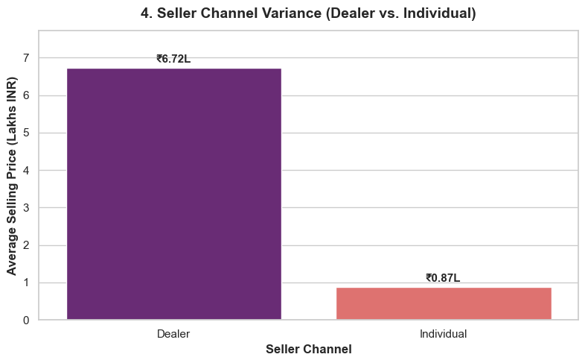
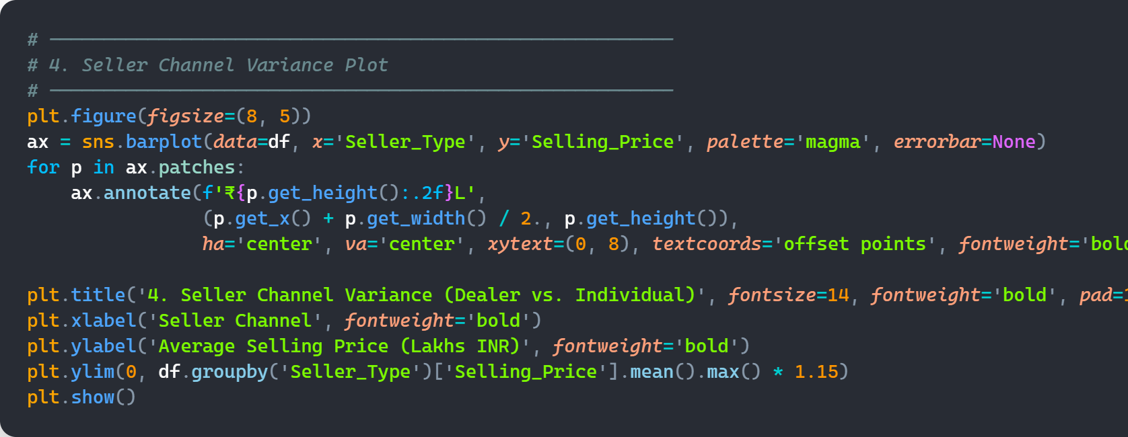
RESULTS
7.7x Price Difference Across Channels: Dealer listings average a much higher selling price (₹6.72 Lakhs) than Individual listings (₹0.87 Lakhs), reflecting dealers' focus on higher-segment pre-owned vehicles.
Markup & Condition Advantage: The higher dealer valuation stems from vehicle reconditioning, multi-point inspection warranties, and built-in commercial profit margins, whereas individual listings consist of direct, un-refurbished consumer sales
https://github.com/Vitry543/used-car-price-analysis/

Slide 9

Thank you
.
.

